Slide 1
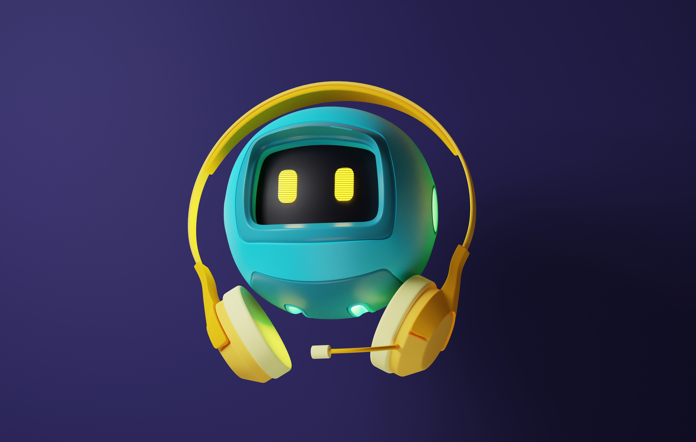
ADVANCING ALZHEIMER'S CARE: INTEGRATING AI FOR ENHANCED SUPPORT AND SAFETY
Presented by :
Swathi S (210701274)
Tamanna (210701281)
Tejashree D (210701287)

Slide 2
ABSTRACT
Alzheimer's disease presents numerous challenges for patients and caregivers, including memory impairment, disorientation, communication difficulties, and behavioral changes. These issues significantly impact daily life, increasing stress, isolation, and safety concerns. One of the most distressing aspects is the tendency for patients to forget themselves, their activities, and experience loneliness. This study proposes leveraging machine learning (ML) algorithms to address loneliness, employing interactive chatbots to provide answers and companionship. Additionally, integrating IoT devices can aid in fall prevention by alerting caregivers to irregular movement patterns, reducing the risk of serious injuries. Continuous learning mechanisms improve the system's ability to identify individual-specific fall risks over time. This inclusive system aims to support dementia patients and caregivers effectively.

Slide 3


EXISTING SYSTEM
The current Alzheimer's care system relies heavily on manual methods for cognitive and emotional support, lacking automated tools for monitoring well-being and detecting falls. Without real-time tracking, emergency response is limited. Additionally, medication management depends on manual reminders, leading to inconsistencies. Overall, the system's reliance on manual interventions hinders efficiency and personalized support for patients and caregivers.

Slide 4
PROPOSED SYSTEM
The proposed system is an AI-ML integrated chatbot designed specifically for Alzheimer’s patients, offering a multifaceted approach to addressing their unique needs. The system comprises several key components: a chatbot module employing advanced Natural Language Processing (NLP) algorithms for cognitive assistance and emotional support; a fall detection module using ML algorithms to analyze motion data from sensors, providing immediate alerts for falls or unusual movements; and a personalized reminder module to manage patients' daily routines and medication schedules. This comprehensive mobile application aims to enhance the quality of care for Alzheimer’s patients by providing tailored support and reducing the caregiving burden through real-time, adaptive, and responsive assistance.

Slide 5
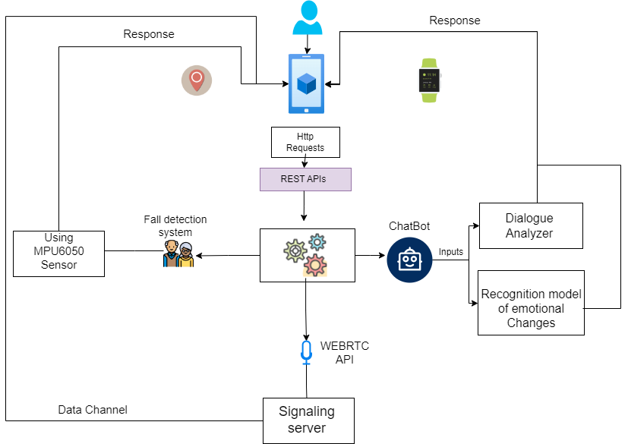
SYSTEM ARCHITECTURE

Slide 6

MODULE DESCRIPTION
Module 1
Module 2
Module 3
This module is a simple interactive chatbot developed to eradicate the loneliness of Alzheimer patients. This module primarily uses Python Language. The range of question answered by the chatbot is for instance, addresses the simple and personal details of the patient such as name, age, family background, medical details and medications taken by patient. Additionally, it also answers basic life questions. This module is trained and tested with predefined datasets which are usually patients’ information.
This module is an IoT-based solution for fall detection among elderly individuals. With the use of NodeMCU and MPU6050 sensors, continuous monitoring of orientation and acceleration is done. Falls are swiftly identified using predefined thresholds. Upon detection, real-time SMS alerts are sent via Blynk app by the integration of API technology, enabling prompt caregiver intervention and minimizing injury risks.
This module primarily focuses on real time communication with the caregivers without the need of phone call. They can lively interact with their caregivers by the integration of WebRTC technology. a simple JavaScript API. WebRTC is a unique way of providing communication. Moreover, communic ation does not necessarily have to include or reflect the value of normal communication. This works similar to the working model of a simple walkie-talkie.

Slide 7
RESULTS
The AI-ML integrated chatbot for Alzheimer’s patients showed significant improvements in both patient care and caregiver support. The chatbot module effectively provided cognitive and emotional assistance, while the sentiment analysis module successfully monitored and identified distress signals, prompting timely alerts to caregivers. The fall detection module accurately identified falls and unusual movements, ensuring prompt emergency responses and increased patient safety. The personalized reminder module improved medication adherence and daily routine management. Overall, the system reduced caregiver burden and enhanced the quality of life for patients, demonstrating the significant potential of AI-ML technologies in healthcare.

Slide 8
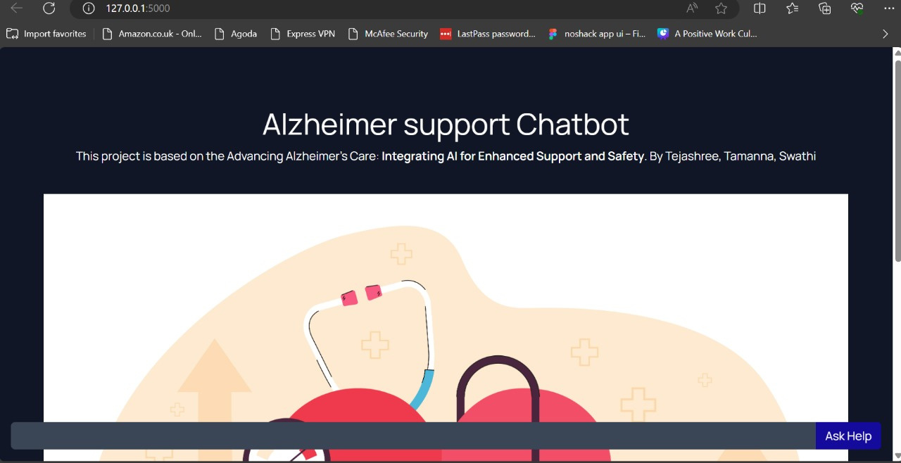

Slide 9
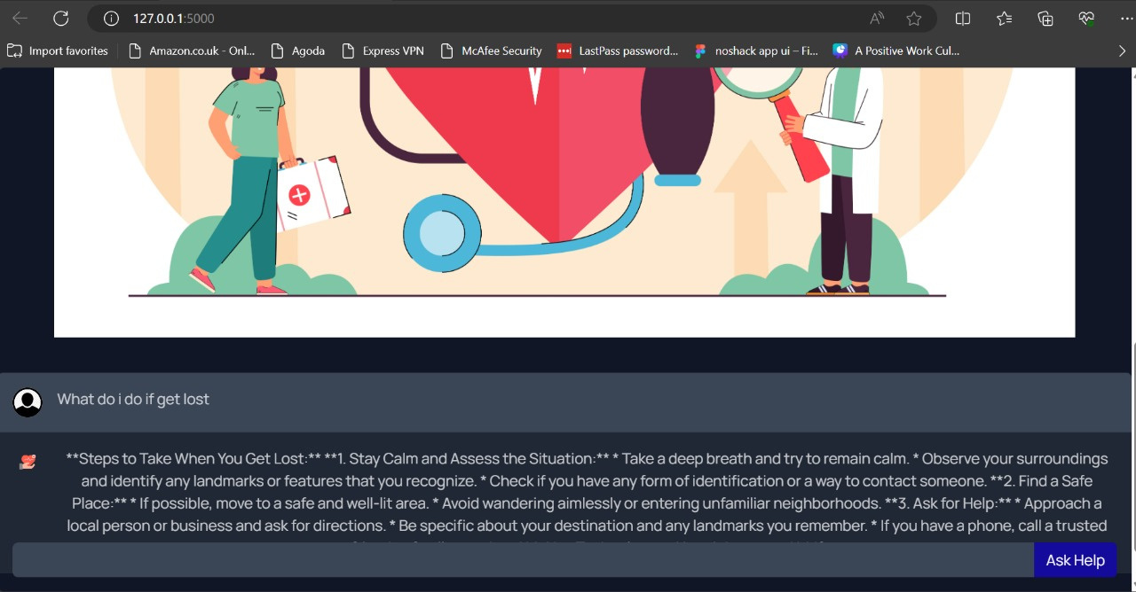

Slide 10
DISCUSSION
The AI-ML integrated chatbot for Alzheimer’s patients advances healthcare by combining cognitive assistance, emotional support, fall detection, and personalized reminders. Utilizing NLP, the chatbot aids cognitive function and reduces isolation. Sentiment analysis monitors emotional well-being, alerting caregivers promptly. Fall detection ensures rapid emergency responses, enhancing safety. Personalized reminders improve medication adherence and daily routines, easing caregiver burden. Key challenges include data privacy, security, and user-friendliness. This system showcases AI and ML's potential in improving Alzheimer’s patient care.

Slide 11
CONCLUSION
In conclusion, the AI-ML integrated chatbot for Alzheimer’s patients represents a significant advancement in healthcare technology, offering multifaceted support tailored to the unique needs of patients and caregivers. This system provides cognitive assistance, emotional support, fall detection, and personalized reminders, improving patient care while reducing caregiver burden. Moving forward, future enhancements such as expanding language support, incorporating predictive analytics, improving user interface design, and strengthening data privacy measures will further enhance the system's effectiveness and adaptability, ensuring continued improvement in Alzheimer’s patient care.

Slide 12
FUTURE ENHANCEMENTS
To further enhance the AI-ML integrated chatbot for Alzheimer’s patients, several improvements can be made. Expanding language support will cater to a more diverse patient demographic, ensuring inclusivity. Incorporating advanced predictive analytics could help anticipate patient needs and potential health issues, allowing for proactive interventions. Improving the user interface design will enhance accessibility, making the system more user-friendly for both patients and caregivers. Additionally, strengthening data privacy and security measures will be crucial to maintain patient confidentiality and trust. Integrating wearable technology for continuous monitoring and developing more personalized care plans based on individual patient data can also significantly enhance the system's overall effectiveness.

Slide 13


THANK YOU

